Slide 1



The Geologic History of Mars
Colleen Watling
Northern Arizona University
Mentors: Dr. Nadine Barlow and Dr. Ken Tanaka

Slide 2
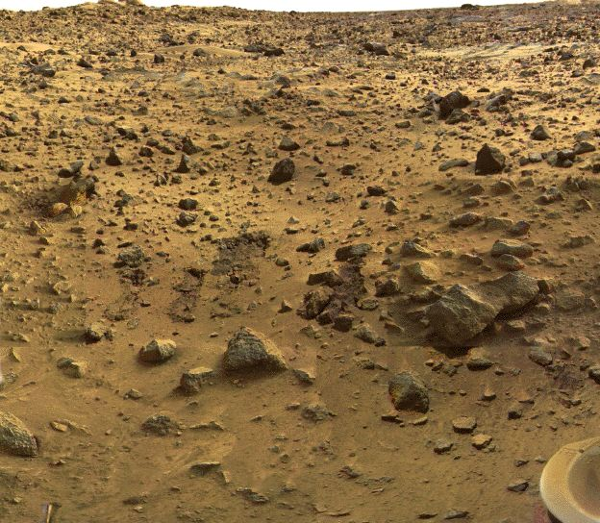
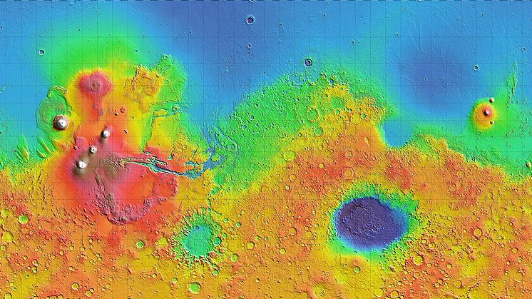
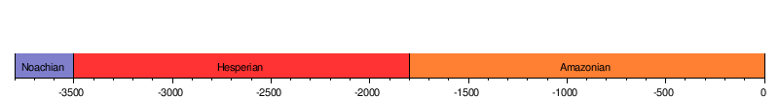
Introduction
Similar features to Earth and Moon
Mars composition
Geologic history
  No plate tectonics
  Impacts
Geologic epochs
  Noachian
  Hesperian
  Amazonian
3.8 Ga 3.5 Ga 3.0 Ga 0
Modified from: http://en.wikipedia.org/wiki/Geology_of_Mars

Slide 3
Project Objectives
PART I: Produce a digital journal of Mars geologic history and mapping
PART II: Complete analysis and possible correlation of central pit craters on Mars to specific geologic units

Slide 4
Data-Digital Journal
Utilized NASA’s astrophysics data system bibliographic services (ADSABS)
Includes references to 106 journal articles and 23 geologic maps
Categorized into 14 areas of geologic study
Title | Author(s) | Journal | Keywords | Link to Full-Text
Geologic settings of Martian Gullies: Implications for their origins | Treiman, A.L. | JGR-Planets | Mars, Hydrology, Gomorphology, Glaciology | http://www.agu.org/journals/je/je0303/2002JE001900/
Oblique rifting at Tempe Fossae, Mars | Fernandez, C. and Anguita, F. | JGR | Tectonics, Fractures and Faults, local crustal structure, Tectonics and Magmatism | http://www.agu.org/journals/je/je0709/2007JE002889/
Impact constraints on the age and origin of the lowlands of Mars | Frey, H.V. | Geophysical Research Letters | Impact Phenomena, Cratering, Origin and Evolution, General or Misc. | http://www.agu.org/journals/gl/gl0605/2005/GL024484/

Slide 5
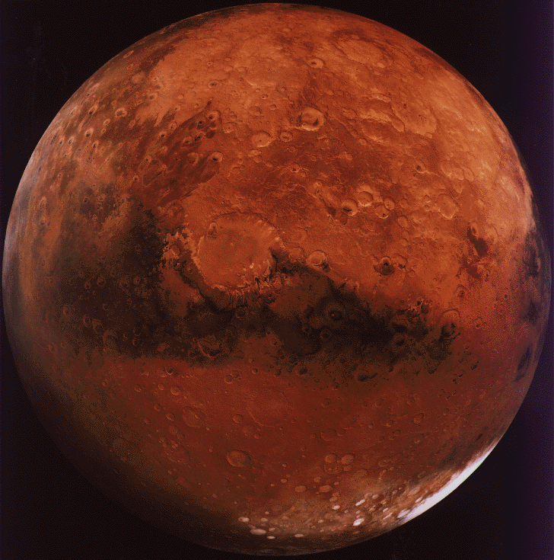
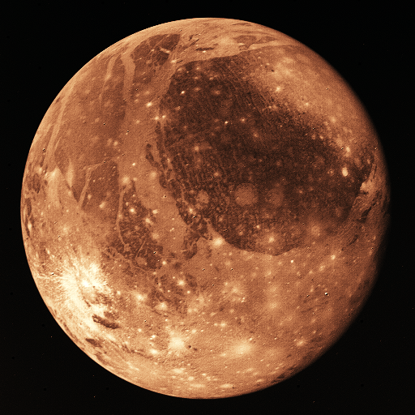
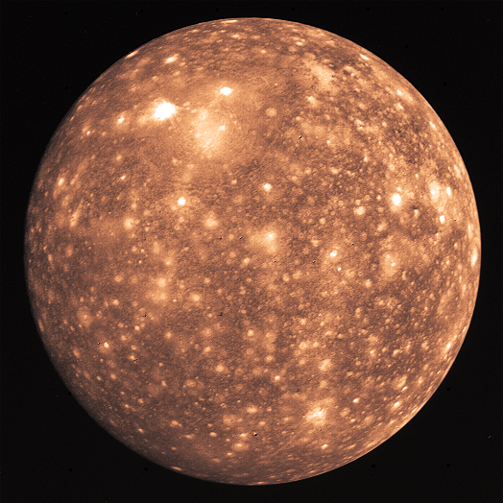
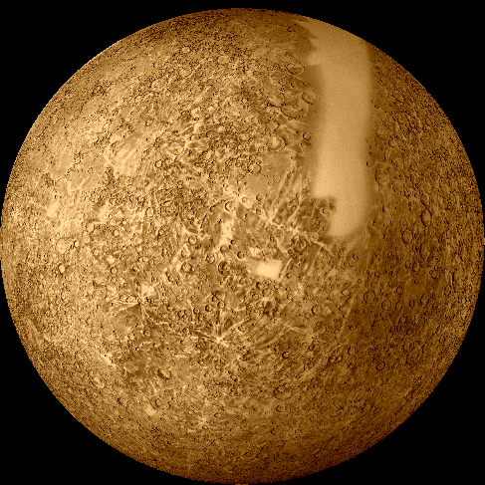
Central Pit Craters
Unique structures to Mars, Ganymede and Callisto
  3 models for formation of central pit craters
  Favored model
  Pit craters on Mercury, but are very different
Mars Ganymede Callisto Mercury
R= 3397 km R= 2634 km R= 2403 km R= 2439 km

Slide 6
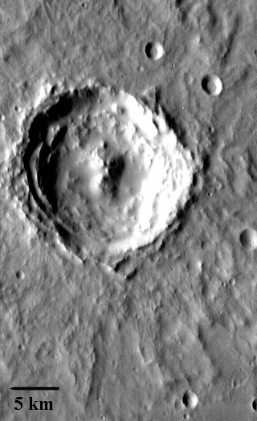
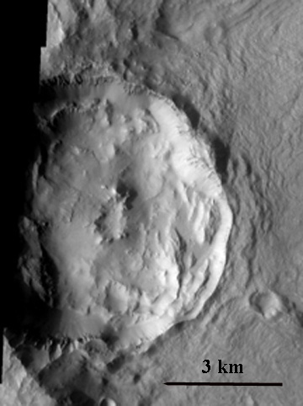
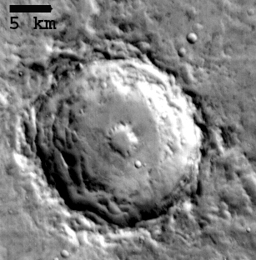
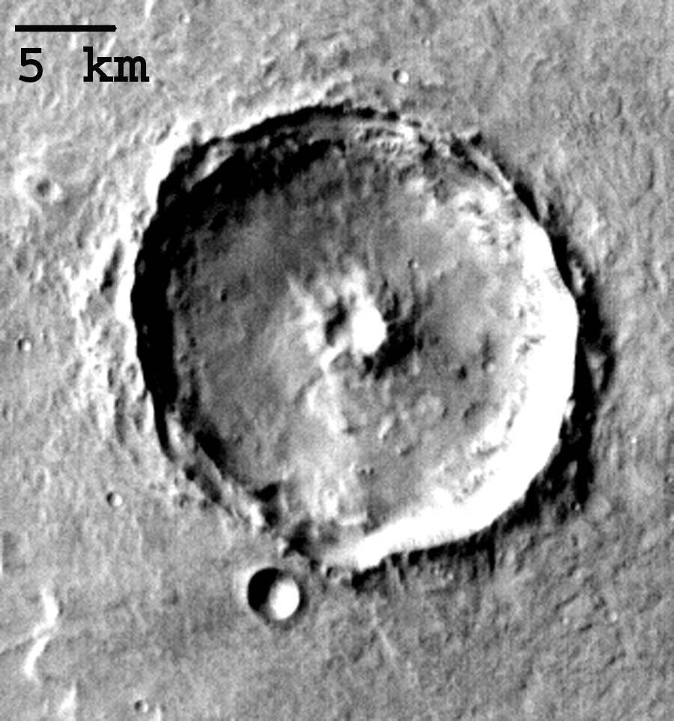
Central Pit Analysis
Global Geologic Map of Mars- Tanaka et .al., 1988
Mars Northern Hemisphere Crater Data- Barlow, 2010
  Concentrated on 3 types of central pit craters and central peaks craters
Symmetric Floor Pit
Asymmetric Floor Pit
Summit Pit
Central Peak

Slide 7
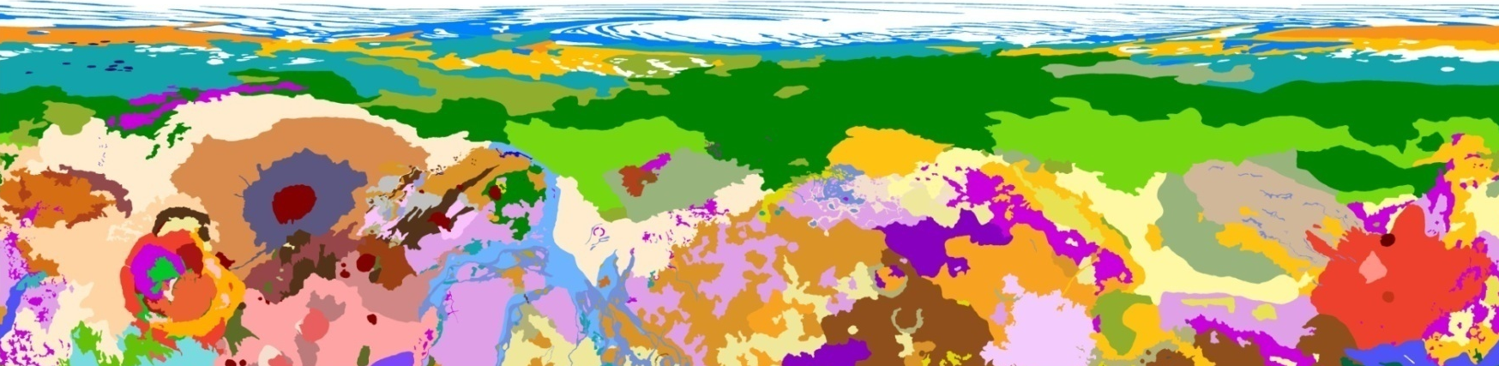
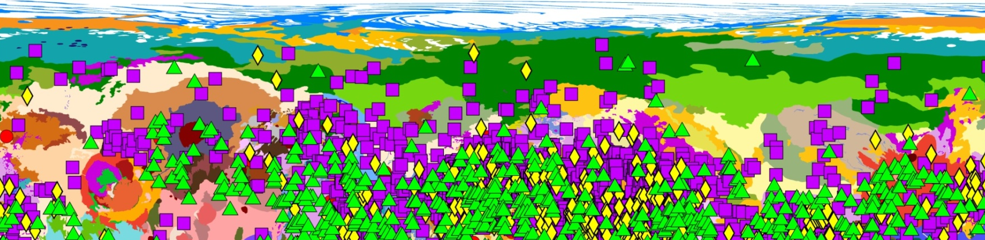
Analysis
  Analyzed craters with respect to:
    Latitude and longitude
    Volcanic, partially volcanic, and non-volcanic units
= Symmetric floor pit
=Asymmetric floor pit
=Summit pit
=Central peak

Slide 8
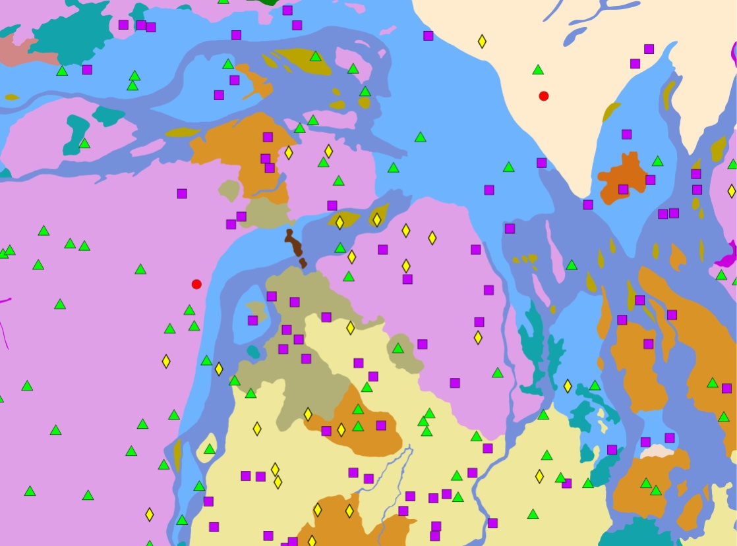
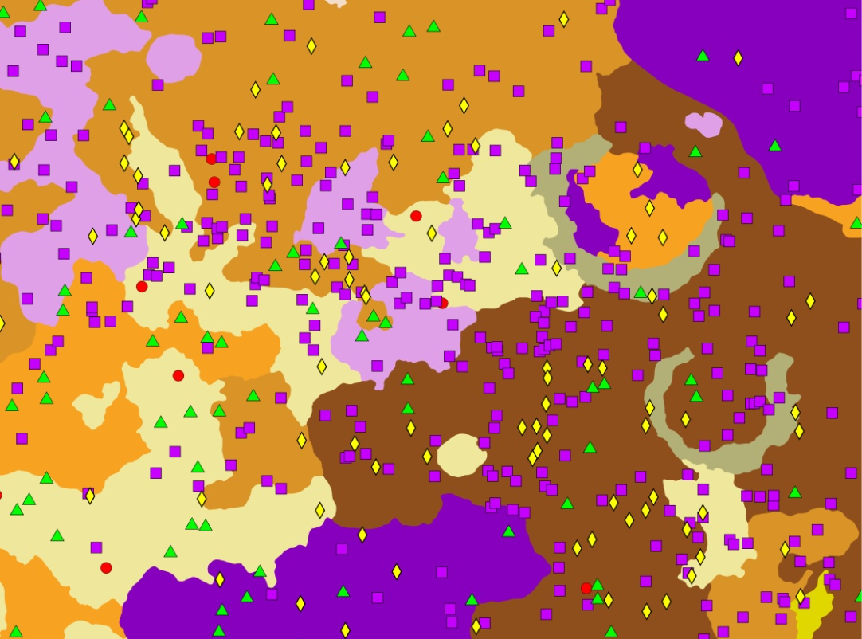
= Symmetric floor pit
=Asymmetric floor pit
=Summit pit
=Central peak
Mostly non-volcanic and partially volcanic units
All volcanic and partially volcanic units
*both images are ~2500 km across*

Slide 9
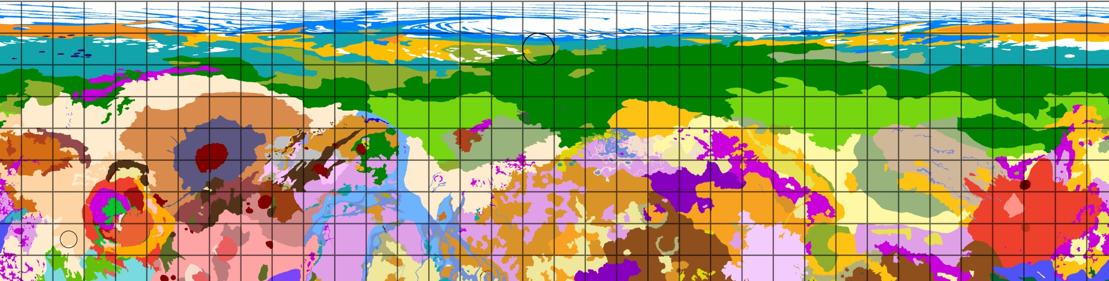
Summit Pit Percentages
-compared to All crater types-
20% summit pits; volcanic units
25% summit pits; partially volcanic units
Only 4 craters, 1 summit pit crater

Slide 10
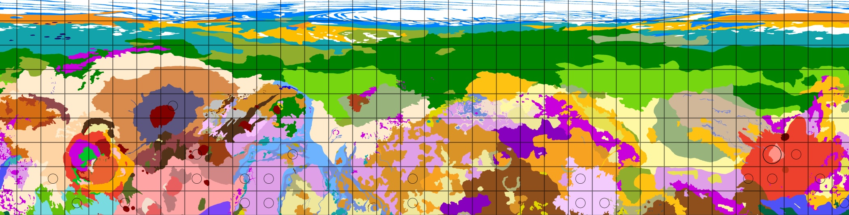
Floor Pit Percentages
-compared to All crater types-
20-30% floor pits; volcanic units
22-29% floor pits; mostly volcanic units
29-38% floor pits; volcanic units

Slide 11

Central Peak Percentages
-compared to All crater types-
43% central peaks; volcanic units
67% central peaks; mostly volcanic units
33-53% central peaks; volcanic and partially volcanic units

Slide 12
Conclusions
Highest Frequencies are at …
Summit pits: 15ºN, volcanic units
Floor pits: 5-25ºN, volcanic units
Central peaks: 5-15ºN, volcanic and partially volcanic units
Favor lower latitudes
More frequent in volcanic units
Future work:
  Southern hemisphere of Mars
  Continue to check results against different formation models

Slide 13
Acknowledgements
Dr. Nadine Barlow and Dr. Ken Tanaka
Trent Hare, USGS, Flagstaff
Arizona Space Grant Consortium
NAU Space Grant Office

Slide 14
QUESTIONS…

